Slide 1
React Forms
Lecturer: Ngo Huy Bien
Software Engineering Department
Faculty of Information Technology
VNUHCM - University of Science
Ho Chi Minh City, Vietnam
nhbien@fit.hcmus.edu.vn

Slide 2

Objectives

Slide 3

Contents

Slide 4

References

Slide 5
Uncontrolled Inputs
Uncontrolled inputs are like standard HTML form inputs.
They remember exactly what you typed, being the DOM itself that maintains that internal state.
How can you then get their value? The answer is by using a React useRef.
The returned value from the useRef hook invocation is an object.
In other words, you must pull the value from the field when needed.

Slide 6
1. Create Uncontrolled Input
npm init react-app 01-uncontrolled-input
cd 01-uncontrolled-input
npm start
const Form = () => {
return (
<div>
<input type="text" />
</div>
);
};
function App() {
return (
<Form />
);
} export default App;

Slide 7
2. Add useRef
import { useRef } from "react";
const Form = () => {
const nameRef = useRef(null);
const handleSubmit = () => {
const name = nameRef.current.value;
alert("Hello " + name);
}
return (
<form onSubmit={handleSubmit}>
<input ref={nameRef} type="text" />
<input type="submit" value="Send"></input>
</form>
);
};

Slide 8
Controlled Inputs
Controlled inputs accept their current value as a prop and a callback to change that value.
The value prop is used to hook the local state up and onChange prop is used to receive the changes and update the state accordingly.
State delegation is performed via the value prop. A combination of local state and the value prop is needed to create a controlled component.
This flow pushes the value changes to the form component.
The Form component always has the input's current value without needing to ask for it explicitly.
Forms can respond to input changes immediately, for example, by:
Instant validation per field
Disabling the submit button unless all fields have valid data
Enforcing a specific input format, like phone or credit card numbers

Slide 9
3. Create Controlled Input
import { useState } from "react";
const Form = () => {
const [name, setName] = useState("");
const handleChange = (e) => {
setName(e.target.value)
}
const handleSubmit = (e) => {
e.preventDefault();
alert("Hello " + name);
}
return (
<form onSubmit={handleSubmit}>
<input type="text"
value={name}
onChange={handleChange}
/>
<input type="submit" value="Send"></input>
</form>
);
};

Slide 10
File Input
In React, an <input type="file" /> is always an uncontrolled component because its value is read-only and can't be set programmatically.

Slide 11
4. Create File Input
import { useRef } from "react"; const Form = () => {
const uploadFiles = useRef(null);
const handleSubmit = (e) => {
e.preventDefault();
const files = uploadFiles.current.files;
alert(files[0].name)
} return (
<form onSubmit={handleSubmit}>
<input
ref={uploadFiles}
type="file"
/>
<input type="submit" value="Send"></input>
</form>
);
};

Slide 12
Uncontrolled vs. Controlled Components
Feature | Uncontrolled | Controlled
One-time value retrieval (e.g. on submit) | Yes | Yes
Validating on submit | Yes | Yes
Instant field validation | No | Yes
Conditionally disabling a submit button | No | Yes
Enforcing a specific input format | No | Yes
Several inputs for one piece of data | No | Yes

Slide 13


Slide 14
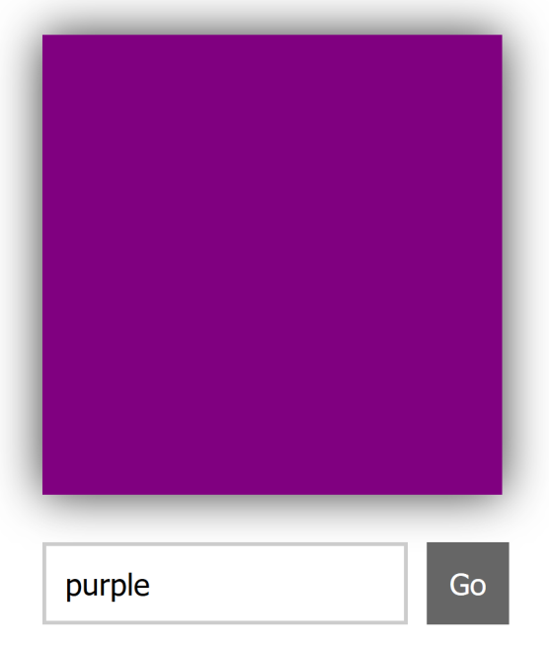
Form Elements
...
setNewBgColor(e){
this.setState({
bgColor: this.state.color
});
e.preventDefault();
}
render() {
var squareStyle = {
backgroundColor: this.state.bgColor
};
return (
<div className="colorArea">
<div style={squareStyle} className="colorSquare"></div>
<form onSubmit={this.setNewBgColor}>
<input onChange={this.}storeColorValue
placeholder="Enter a color value" />
<button type="submit">Go</button>
</form>
</div>
);
}
...

Slide 15
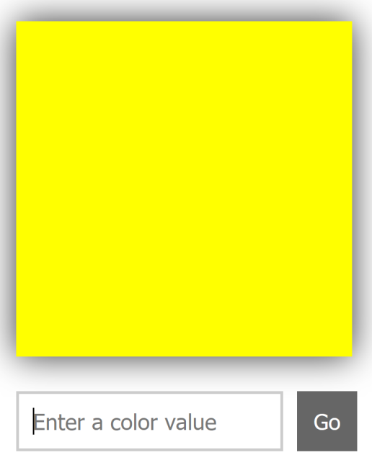
Accessing Form Elements
...
setNewBgColor(e){
this.setState({
bgColor: this.state.color
});
this._input.value = "";
this._input.focus();
...
render() {
var squareStyle = {
backgroundColor: this.state.bgColor
};
var self = this;
return (
<div className="colorArea">
<div style={squareStyle} className="colorSquare"></div>
<form onSubmit={this.setNewBgColor}>
<input
ref={
function(el) {
self._input = el;
}
}
onChange={this.storeColorValue}
placeholder="Enter a color value" />
...
To provide a bridge between JSX and the final HTML elements in the DOM, React provides us with something funnily known as refs (short for references).

Slide 17

Further Reading
https://formik.org/
The most popular open source form library for React. It saves you lots of time when building forms and offers a declarative, intuitive and adoptable paradigm.
https://github.com/jquense/yup
An open-source library that integrates perfectly with Formik. It allows you to set all your form validation rules declaratively.
https://github.com/react-hook-form/react-hook-form
Another popular library to easily manage your form state and validation rules.

Slide 18

Thank You & See You Again

